Slide 1
Formal Language & Automata Theory

Slide 2
Properties of Regular Languages
Which languages are not regular?
Decision properties
A decision property for a class of languages is an algorithm that takes a formal description of a language (e.g., a DFA) and tells whether or not some property holds.
Is a regular language empty?
Is a string w belong to the language?
Do different descriptions languages describe same language?

Slide 3
Closure properties
A closure property of a language class says that given languages in the class, an operator (e.g., union) produces another language in the same class.
The union of two regular languages is regular
The intersection of two regular languages is regular
The complement of a regular language is regular
The difference of two regular languages is regular
The reversal of a regular language is regular
The closure (star) of a regular language is regular
The concatenation of regular languages is regular
A homomorphism (substitution of strings for symbols) of a regular language is regular
The inverse homomorphism of a regular language is regular

Slide 4
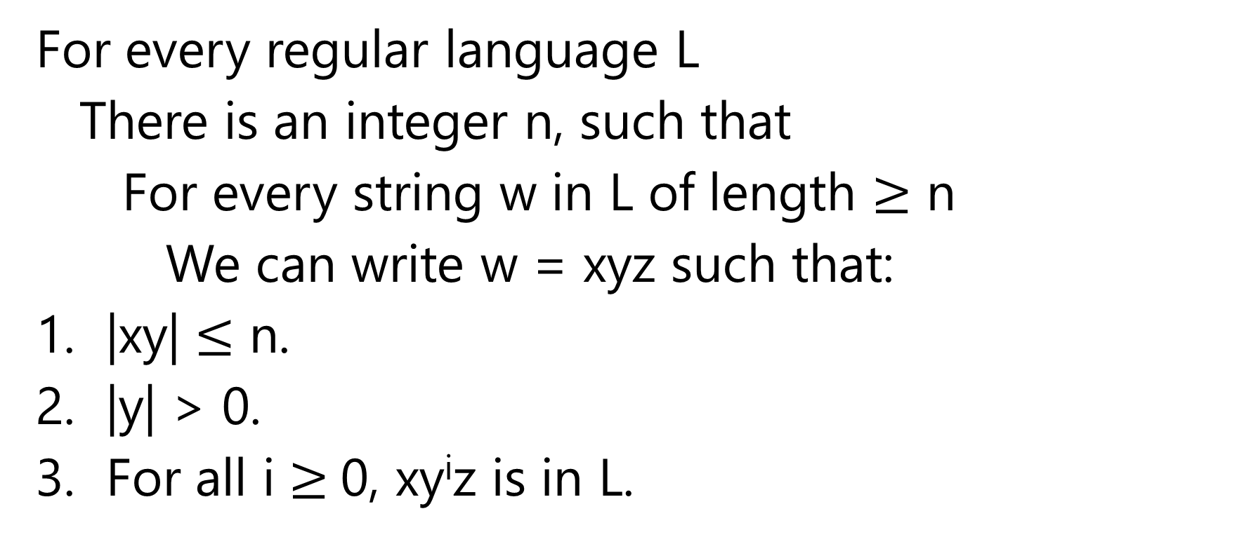
Pumping Lemma for Regular Languages
Number of states of DFA for L
For every regular language L
There is an integer n, such that
For every string w in L of length $≥$ n
We can write w = xyz such that:
|xy| $≤$ n.
|y| > 0.
For all i$≥$0, xy^{i}z is in L.
Labels along first cycle on
path labeled w

Slide 5
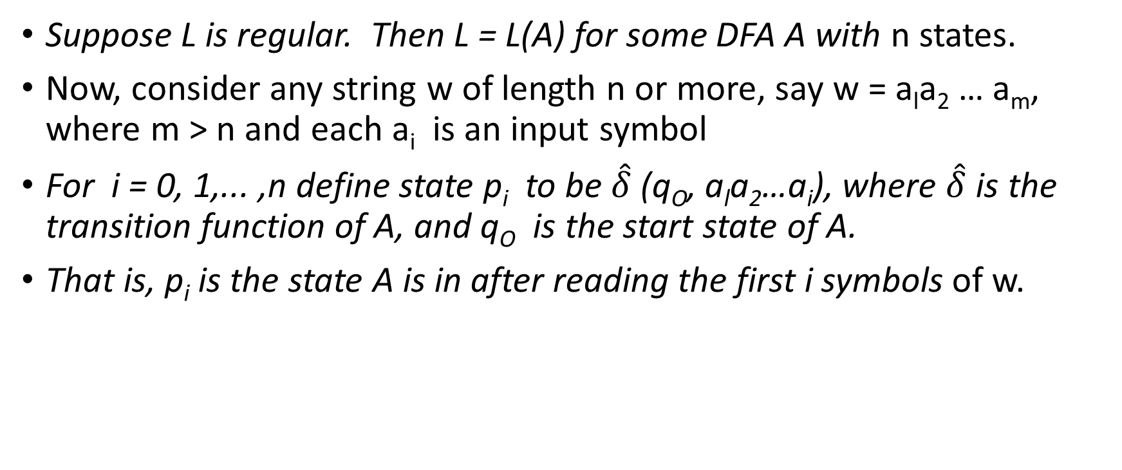
Proof: Pumping Lemma for Regular Languages
Suppose L is regular. Then L = L(A) for some DFA Awithn states.
Now, consider any string w of length n or more, say w = a_{l}a₂… a_{m}, where m > n and each a_{i} is an input symbol
For i = 0, 1,... ,n define state p_{i}to be $\hat{δ}$(q_{O}, a_{l}a₂…a_{i}), where $\hat{δ}$ is the transition function of A, and q_{O} is the start state of A.
That is, p_{i} is the state A is in after reading the first i symbols of w.

Slide 6
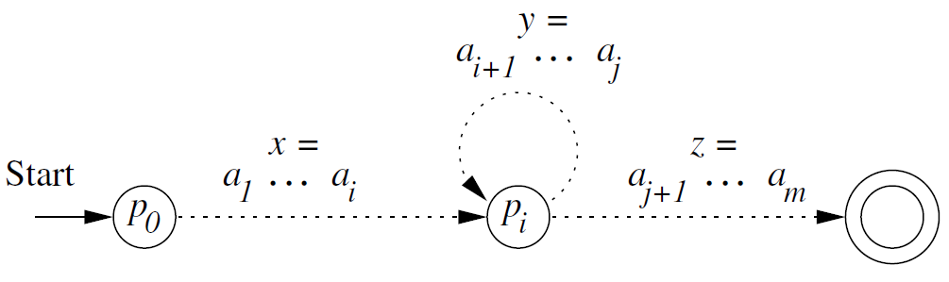
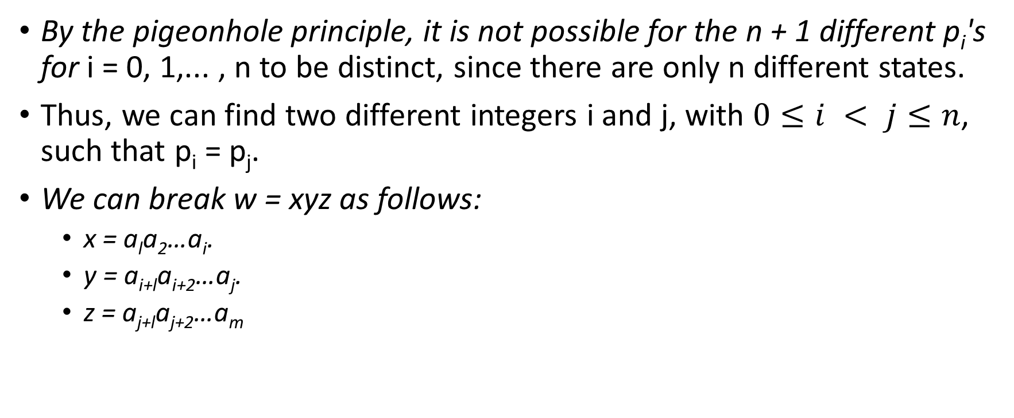
Proof: Pumping Lemma for Regular Languages
By the pigeonhole principle, it is not possible for the n + 1 different p_{i}'s for i = 0, 1,... , n to be distinct, since there are only n different states.
Thus, we can find two different integers i and j, with $0≤i < j≤n$, such that p_{i} = p_{j}.
We can break w = xyz as follows:
x = a_{l}a₂…a_{i}.
y = a_{i+l}a_{i+2}…a_{j}.
z = a_{j+l}a_{j+2}…a_{m}

Slide 7
Proof: Pumping Lemma for Regular Languages
Now, consider input xy^{k}z for any k > 0.
If k = 0,
then the automaton goes from the start state q_{O} (which is also p_{O}) to p_{i} on input x.
Since p_{i} is also p_{j}, it must be that A goes from p_{i} to the accepting state on input z. Thus, A accepts xz.
If k > 0,
then A goes from q_{O} to p_{i} on input x,
circles from p_{i} to p_{i} , k times on input y^{k},
then goes to the accepting state on input z.
Thus, for any k > 0, xy^{k}z is also accepted by A; that is, xy^{k}z is in L.

Slide 8
Pumping lemma contd.
We use pumping lemma to show that a given language is not regular
If the conditions stated in pumping lemma is not satisfied it can not be concluded that the language is regular or not
The trick is to find a suitable value of ‘k’ as mentioned in xy^{k}z and show that the string is not in L

Slide 9
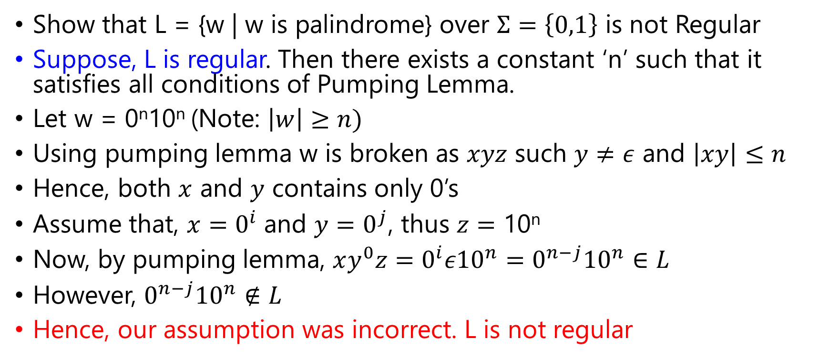
Example: Pumping Lemma
Show that L = {w | w is palindrome} over $Σ=\left\{0,1\right\}$ is not Regular
Suppose, L is regular. Then there exists a constant ‘n’ such that it satisfies all conditions of Pumping Lemma.
Let w = 0^{n}10^{n} (Note: $\left|w\right|≥n)$
Using pumping lemma w is broken as $xyz$ such $y≠ε$ and $\left|xy\right|≤n$
Hence, both $x$ and $y$ contains only 0’s
Assume that, $x=0^{i}$ and $y=0^{j}$, thus $z=\text{10}\text{n}$
Now, by pumping lemma, $xy^{0}z=0^{i}ε10^{n}=0^{n−j}10^{n}∈L$
However, $0^{n−j}10^{n}∉L$
Hence, our assumption was incorrect. L is not regular

Slide 10
Is a regular language empty?
Given a regular language, does the language contain any string at all.
Assume representation is DFA.
Construct the transition graph.
Compute the set of states reachable from the start state.
If any final state is reachable, then yes, else no.

Slide 11
Given regular languages L and M, is L = M?
Construct the product DFA from DFA’s for L and M.
Let these DFA’s have sets of states Q and R, respectively.
Product DFA has set of states Q × R.
i.e., pairs [q, r] with q in Q, r in R.
Start state = [q₀, r₀] (the start states of the DFA’s for L, M).
Transitions: δ([q,r], a) = [δ_{L}(q,a), δ_{M}(r,a)]
δ_{L}, δ_{M} are the transition functions for the DFA’s of L, M.
That is, we simulate the two DFA’s in the two state components of the product DFA.

Slide 12
Example: Product DFA
0
0
1
0
A
B
[A,C]
[A,D]
0, 1
1
1
1
0
0
1
[B,C]
[B,D]
0
1
0
C
D
1

Slide 13
Given regular languages L and M, is L = M?
Make the final states of the product DFA be those states [q, r] such that exactly one of q and r is a final state of its own DFA.
Thus, the product accepts w iff w is in exactly one of L and M.
The product DFA’s language is empty iff L = M.
Use Emptiness checking algorithm to test whether the language of a DFA is empty.

